Slide 1
Name : parekh kishan ranchhodbhai exam number : semester : 6 project guide : ms. heema patel
Library Management System

Slide 2
INTRODUCTION
The project titled Library Management System is Library Management software for monitoring and controlling the transactions in a library.
The project “Library Management System” is developed in PHP, which mainly focuses on basic operations in a library like adding new books, and updating new information, searching books and members and return books.
This project of “LIBRARY MANAGEMENT” of gives us the complete information about the library. We can enter the record of new books and retrieve the details of books available in the library.
We can issue the books to the students and maintain their records and can also check how many books are issued and stock available in the library. In this project we can maintain the late fine of students who returns the issued books after the due date.
Throughout the project the focus has been on presenting information and comments in an easy and intelligible manner. The project is very useful for those who want to know about Library Management System.

Slide 3
2. SCOPE OF WORK
Objective:
To develop a secure library management system with distinct modules for Admin and Users. Admins can manage books, users, categories, and issues, while users can browse books, manage their profiles, and view issued books.
Admin | User
Secure Login: Encrypted login with session management | Secure Login/Registration: Secure user login and registration
Admin Dashboard: Overview of system stats | User Dashboard: View issued books and due dates
Manage Books & Categories: Add, edit, or delete books and categories | View Book Details: Browse books with detailed info
Issue/Manage Books: Track issues, returns, and renewals | Manage Issued Books: Renew and manage borrowed books
View Users: Manage users and transactions | Manage Profile: Update personal details and passwords
Logout: Secure logout | Logout: Secure logout

Slide 4
3. AN EXISTIN SYSTEM
Koha is an open-source Library Management System (LMS) widely used by libraries around the world.
It allows admins to manage book cataloging, circulation (issues, returns, and renewals), user management, and generate reports like overdue books and fines.
For users, Koha provides features like searching for books, viewing their issued books, managing profiles, and checking due dates and fines.
The system is built on a web-based interface using Perl and MySQL and is customizable to suit specific needs.
Its open-source nature makes it a flexible and secure solution for libraries.

Slide 5
4. NEED OF PROPOSED SYSTEM
Efficient Book Management: Automates book cataloging, tracking, and management, ensuring accurate inventory and easy searchability for both admins and users.
Streamlined Book Issuance & Returns: Automates book issuance, due dates, fines, and returns, reducing manual errors and enhancing operational efficiency.
Secure Login & Access: Provides secure login for both admins and users with role-based access to ensure data privacy and control.
Real-Time Data & Reporting: Generates automated reports on overdue books, fines, inventory, and user activity, enabling better decision-making.
Improved User Experience: Users can easily search books, manage borrowing status, view fines, and update profiles, enhancing convenience and user satisfaction.

Slide 6
5. FEASIBILITY STDUY
Technical feasibility :-
Development Tools: The LMS can be developed using HTML, CSS, JavaScript, PHP, and MySQL. These are widely used technologies and are well-suited for web-based applications.
Hosting: The system can be hosted on either cloud platforms (AWS, Google Cloud) or on-premises servers depending on the library's infrastructure and budget.
Security: The system can implement SSL encryption, secure login, and data backup mechanisms to ensure data privacy and protection.
Integration: The system can be easily integrated with existing software or other platforms if needed (e.g., external databases or digital book repositories).
Operational feasibility :-
Automation: The system will automate tasks such as book cataloging, issue/return management, overdue fines, and user profile management, reducing manual work and errors.
User Interface: The system will be user-friendly, with clear interfaces for both admin and user roles.

Slide 7
6. SYSTEM FEATURES
Admin Features :-
Admin can add/update/ delete category.
Admin can add/update/ delete author.
Admin can add/update/ delete books.
Admin can issue a new book to student and also update the details when student return book.
Students :-
Student can register yourself.
After login student can view own dashboard.
Student can update own profile.
Student can view issued book and book return date-time.

Slide 8
7. FRONT- END TOOL
HTML :-
HTML, Which stands for Hyper Text Markup Language, is the standard markup language used for creating and structuring web pages. It provides the structure and layout of a web page by using various elements and tags.
CSS :-
CSS, Which stands for Cascading Style Sheets is a styling language used to describe the visual presentation of a documents writer in HTML or XML. It allow web developers to control the layout, colors, fonts, and other visual aspects of web pages.
JAVASCRIPT :-
JavaScript is a high-level programming language that is primarily used for Adding interactivity and dynamic behavior to web pages. It allows developers to create interactive elements, handle events, manipulate and update content and communicate with servers.

Slide 9
8. BACK- END TOOL
BACK END – PHP / DATABASE :-
PHP is a scripting language, which is what is needed for interactive websites. Meanwhile, PHP can work alongside HTML.
MySQL :-
MySQL here works s Database Management System.
PHP is an open source language and all its components are free to use and distribute.
PHP is server side scripting language. It is embedded in HTML source code.
Following are the some major advantage :-
Friendly With HTML - PHP and HTML are interchangeable within the page. You can put PHP outside the HTML or inside.
Interactive Features - PHP allows you to interact with your visitors in ways HTML alone can't.

Slide 10
9. HARDWARE REQUIREMENTS
HARDWARE
Item | Minimum Value
CPU | i5 & i3 generation Or Higher
RAM | 256 MB
ROM | 16 GB

Slide 11
10. Software Requirements
SOFTWARE
Operating System | Window 10
Browser | Any
Backend Tool | MYSQL,PHP Database

Slide 12
11. MODULES
Admin modules :
Secure with Login
Admin dashboard
Add / manage category
Add / manage author
Add / manage books
Issue new book / manage Issue book
View student
Logout
User modules :
Secure Login and registration
User dashboard
View book details
View issued book details
View profile
Manage / Update profile
Logout

Slide 13
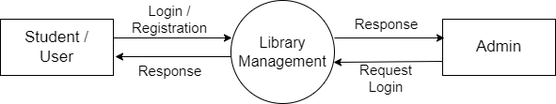
12. DATA FLOW DIAGRAM (DFD)
Context Level :-

Slide 14
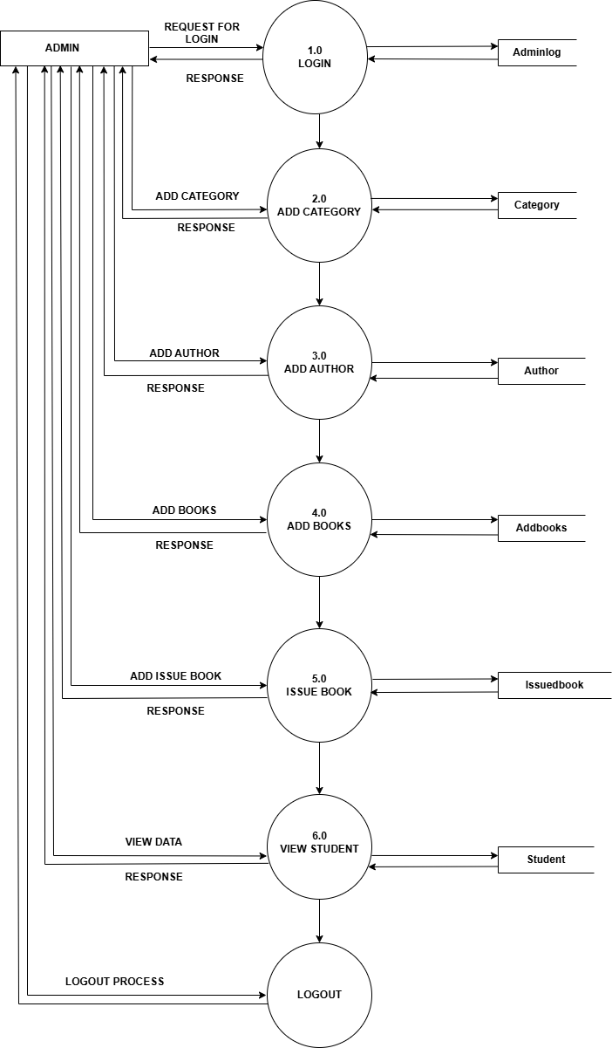
ADMIN SIDE ZERO LEVEL DFD :-

Slide 15
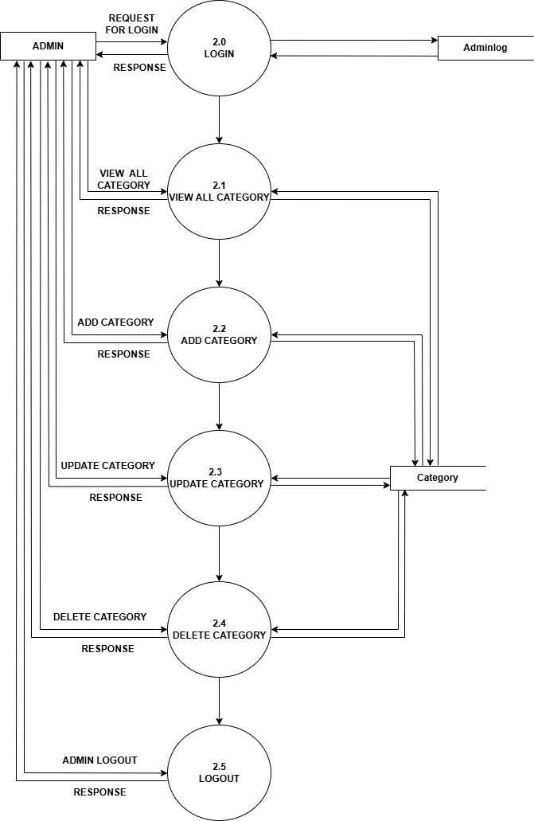
ADMIN SIDE 1st LEVEL DFD :-

Slide 16
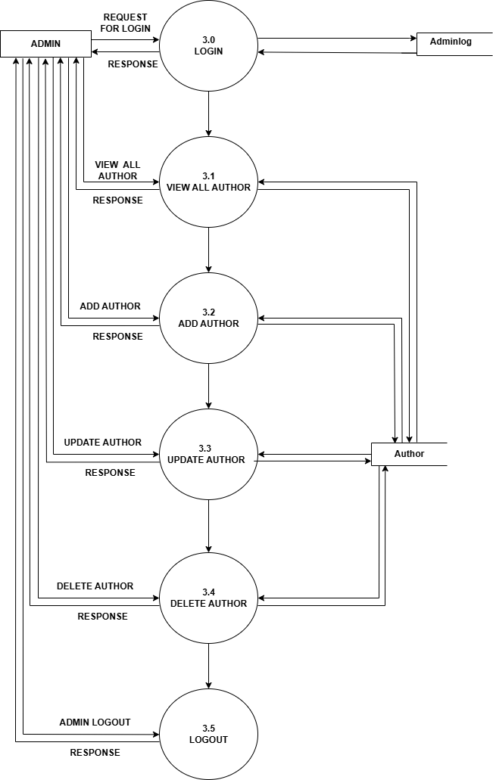
ADMIN SIDE 1.1 LEVEL DFD :-

Slide 17
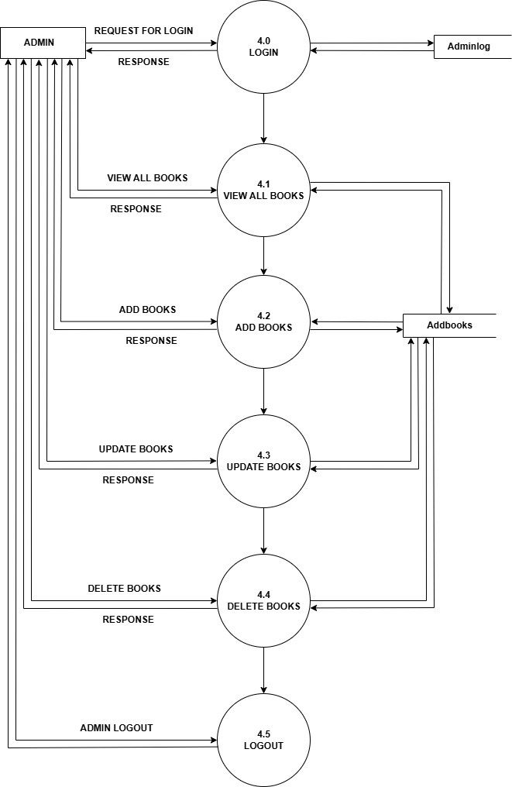
ADMIN SIDE 1.2 LEVEL DFD :-

Slide 18
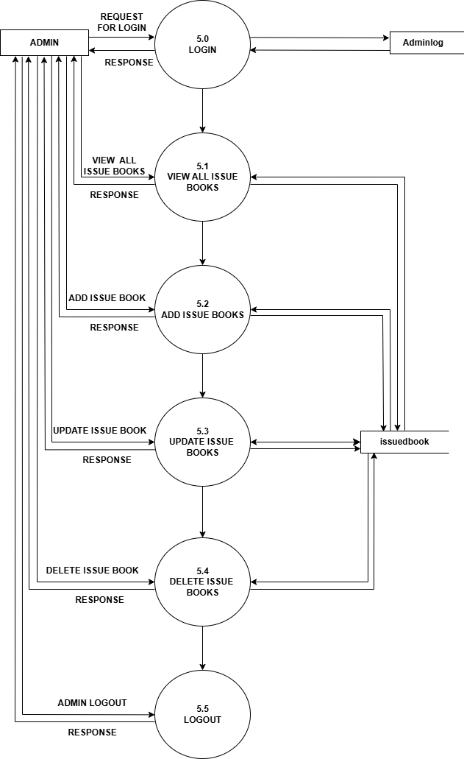
ADMIN SIDE 1.3 LEVEL DFD :-

Slide 19
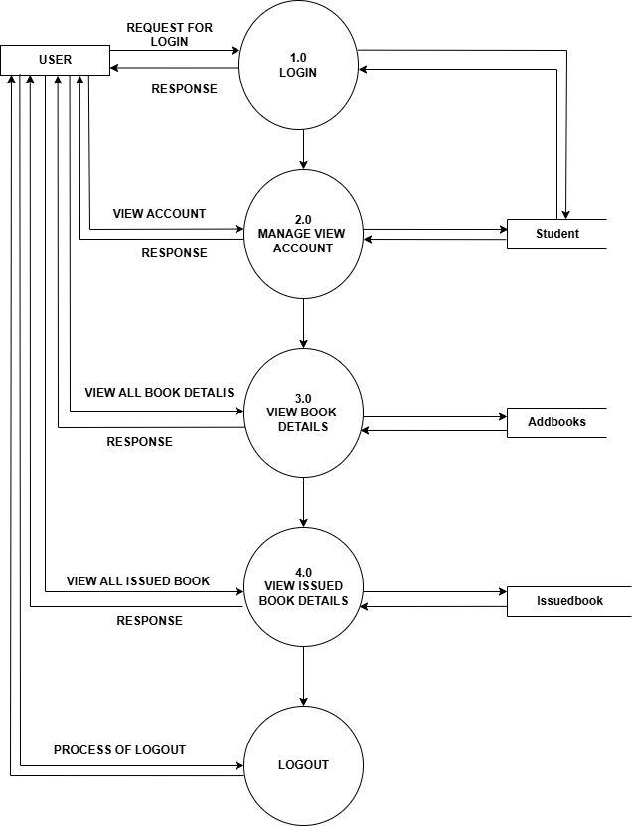
USER SIDE ZERO LEVEL DFD :-

Slide 20
13. DATABASE DICTIONARY
Table_name : Adminlog :-
Column | Datatype | Constraint
Email | Varchar(50) | Not Null
Password | Varchar(30) | Not Null

Slide 21
Table_name : Author :-
Aid :- Primary key (Auto_increment)
Column | Datatype | Constraint
Aid | Int(10) | Primary key (Auto_increment)
Author_name | Varchar(50) | Not Null
Reg_date | Datetime | Not Null ( current_timestamp() )

Slide 22
Table_name : Category :-
Cid :- Primary key (Auto_increment)
Column | Datatype | Constraint
Cid | Int(10) | Primary key (Auto_increment)
Catename | Varchar(50) | Not Null
Reg_date | Datetime | Not Null ( current_timestamp() )

Slide 23
Table_name : Addbooks :-
id :- Primary key(Auto_increment)
Column | Datatype | Constraint
Id | Int(11) | Primary key (Auto_increment)
Bookname | Varchar(25) | Not Null
Catid | Int(11) | Not Null
Authorid | Int(11) | Not Null
isbnnumber | Varchar(25) | Not Null
Bookprice | Decimal(10,2) | Not Null
Bookimage | Varchar(250) | Not Null
Isissued | Int(1) | Not Null
Regdate | timestamp | Not Null ( current_timestamp() )
pdate | Date | Not Null

Slide 24
Table_name : Student :-
Roll_no :- Primary key
Column | Datatype | Constraint
Roll_no | Int(10) | Primary key
Full_name | Varchar(50) | Not Null
Email_id | Varchar(30) | Not Null
M_no | Int(10) | Not Null
Password | Varchar(10) | Not Null
gender | Varchar(10) | Not Null
Field | Varchar(50) | Not Null
Reg_date | Datetime | Not Null ( current_timestamp() )
img | Varchar(250) | Not Null

Slide 25
Table_name : Issuedbook :-
id :- Primary key(Auto_increment)
Column | Datatype | Constraint
Id | Int(11) | Primary Key (Auto_increment)
Bookid | Int(11) | Not Null
Roll_no | int(10) | Not Null
Issuesdate | Datetime | Not Null ( current_timestamp() )
Returndate | Datetime | Not Null On update ( current_timestamp() )
Returnstatus | Int(1) | Not Null
fine | Int(11) | Not Null

Slide 26
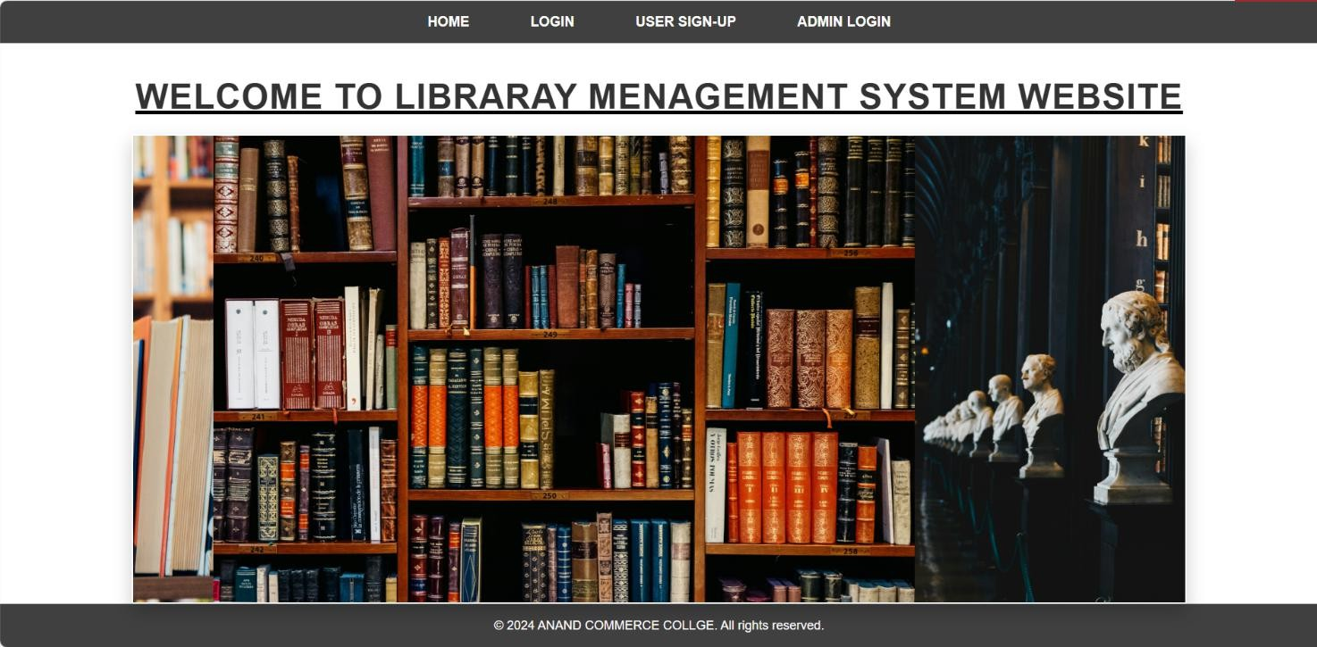
14. DISPLAY OF INPUT & OUTPUT SCREEN & REPORTS
HOME PAGE :-
Displays an introduction to the Library Management System.
Provides navigation options for login, registration, and Admin login

Slide 27
USER SIDE
INPUT & OUTPUT SCREEN

Slide 28
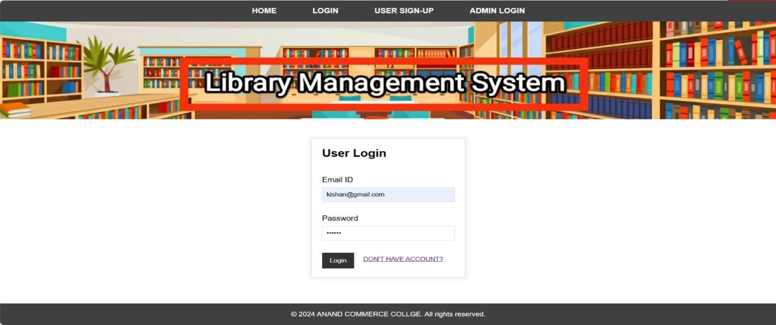
USER LOGIN PAGE :-
Users enter their email and password to access their dashboard.
Redirects to the dashboard if login credentials are correct.

Slide 29
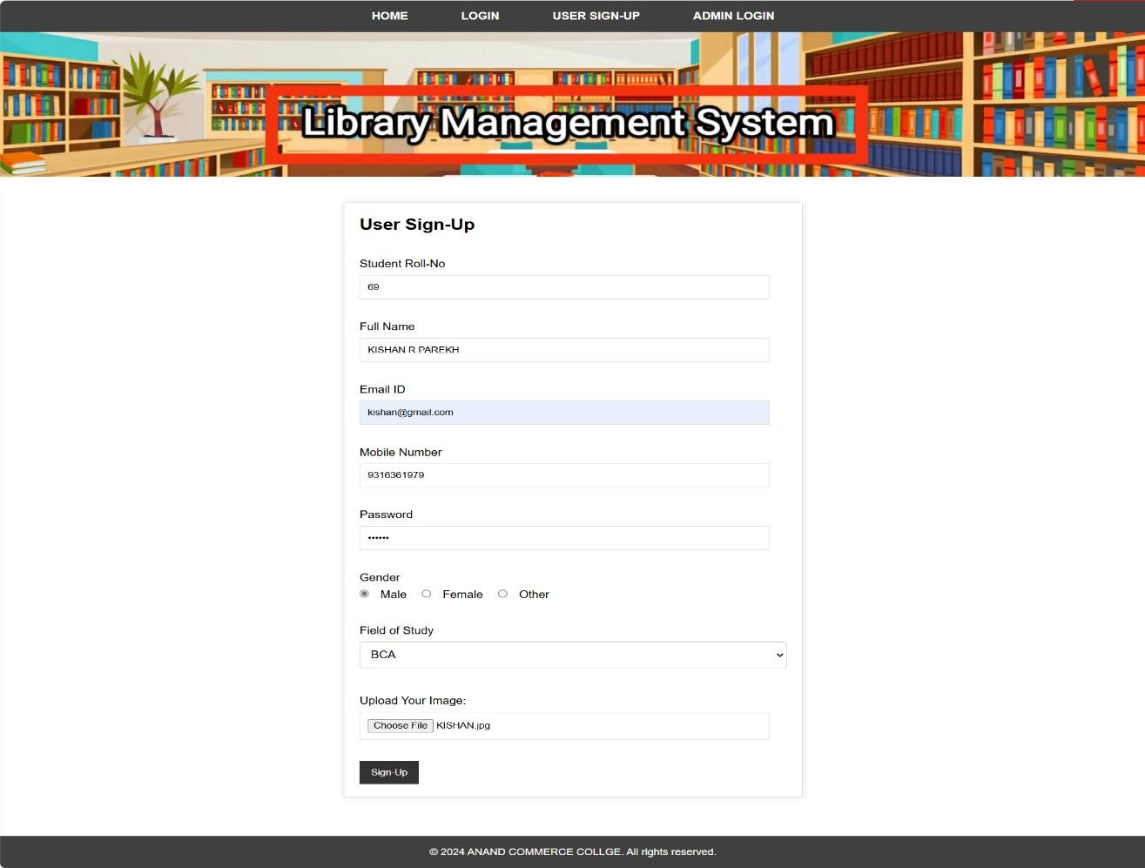
USER SIGN-UP PAGE :-
User Sign-Up Form: A registration page for a Library Management System with fields for student details, study field, and profile image upload.
Secure Access: Includes password protection and gender selection for personalized account creation.

Slide 30
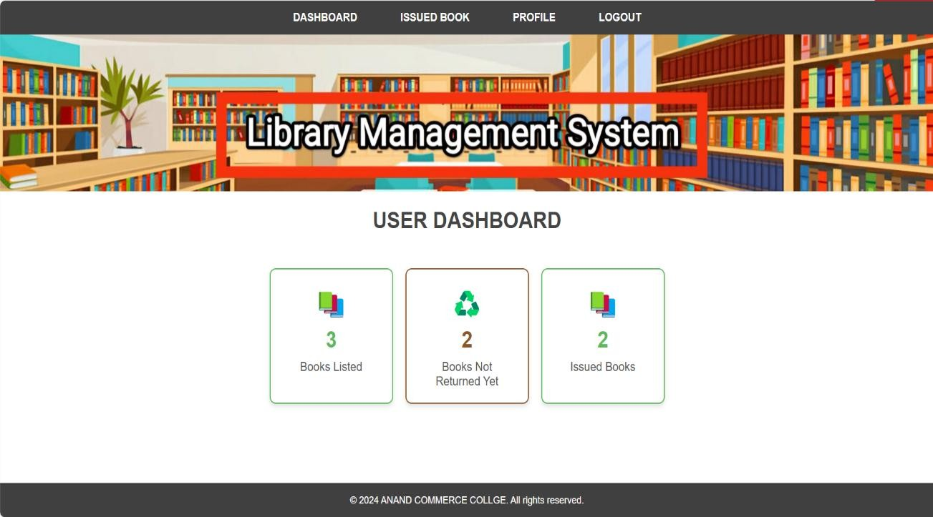
USER DASHBOARD :-
User Dashboard Overview: The image shows a dashboard for a Library Management System, where users can track their listed books, issued books, and books not yet returned.
Simple Navigation: The top menu provides easy access to the dashboard, issued books, user profile, and logout option.

Slide 31
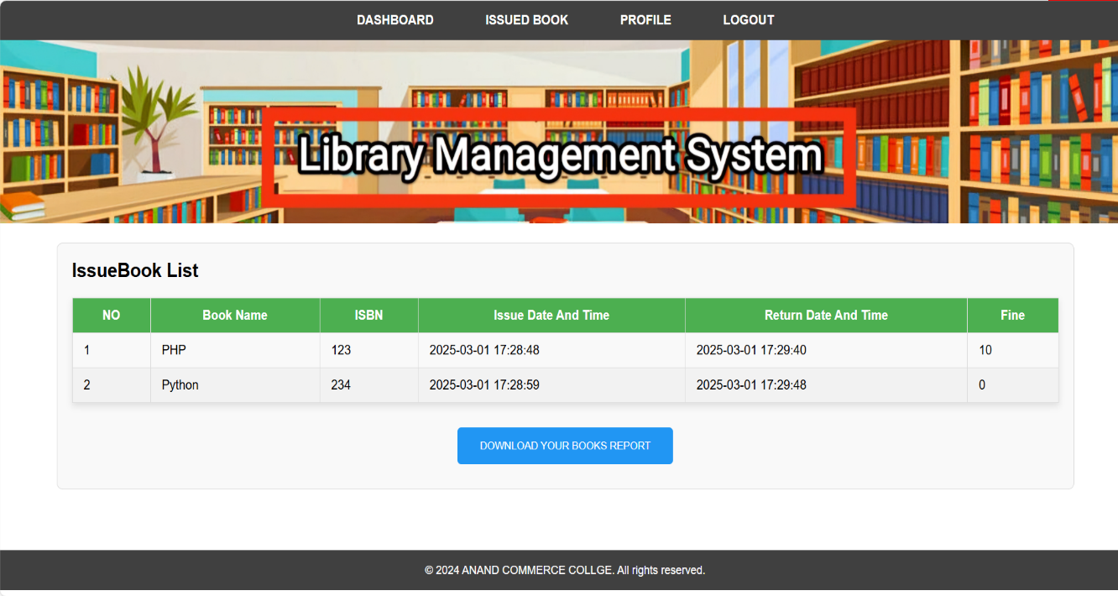
USER ISSUED BOOK LIST :-
Issued Books List: Displays details of issued books, including book name, ISBN, issue/return dates, and any fines.
Download Report: Users can download their book report using the provided button.

Slide 32
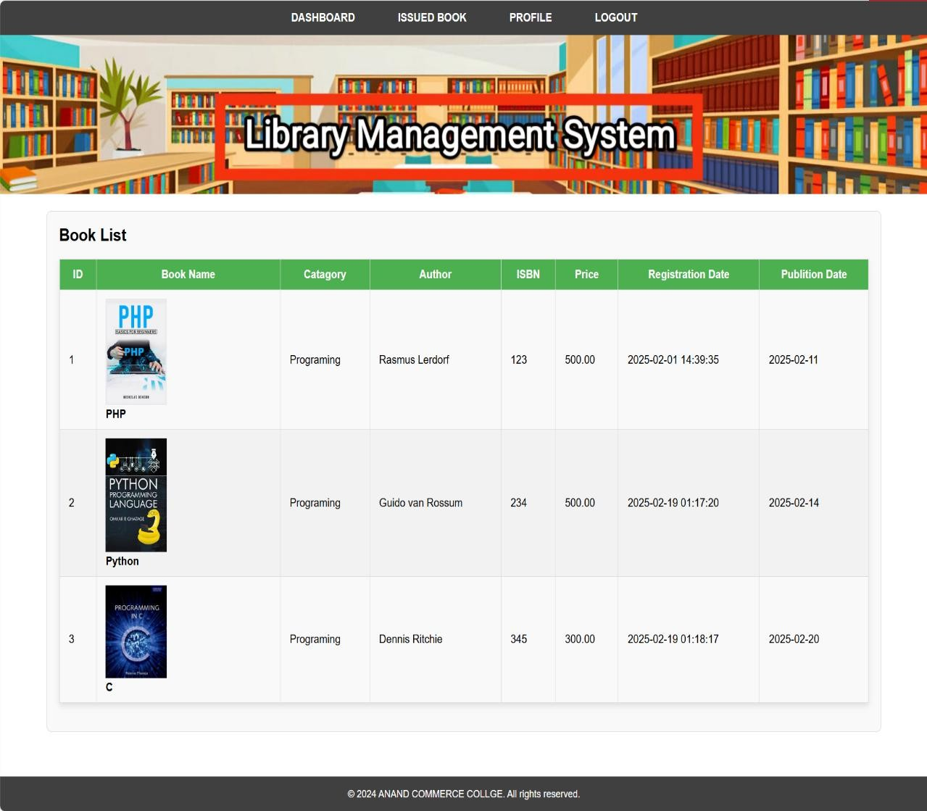
USER VIEW BOOKS :-
Book List Overview: Displays a list of available programming books with details like author, ISBN, price, and publication date.
Book Images & Info: Each book entry includes a cover image, making it easier for users to identify books visually.

Slide 33
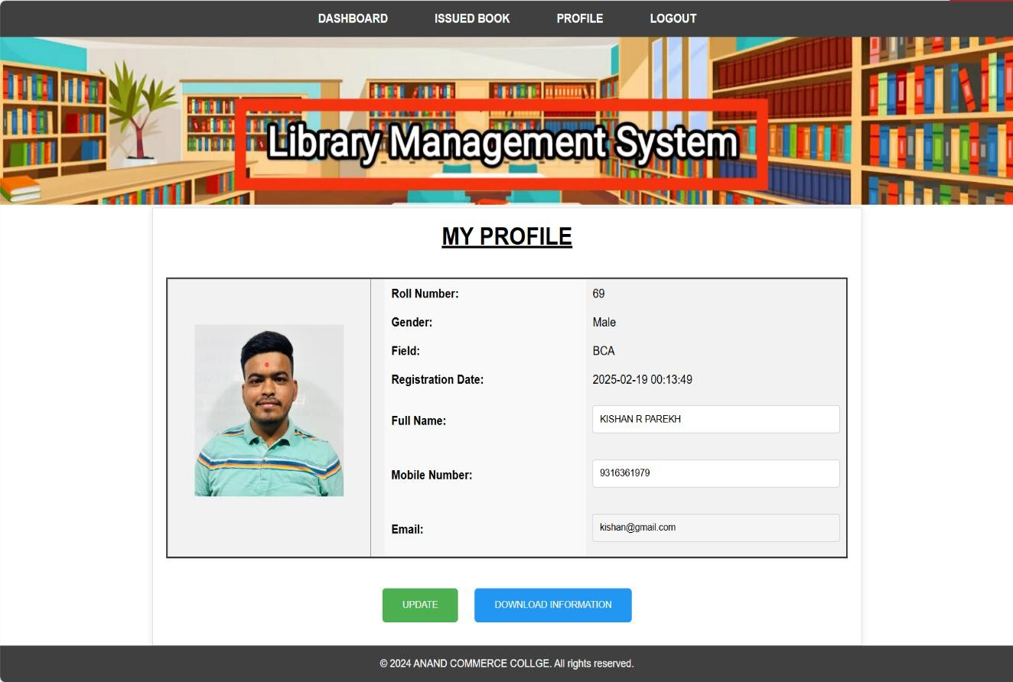
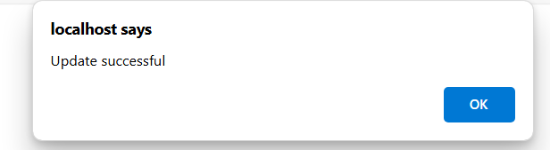
USER PROFILE & USER UPDATE PROFILE :-
UPDATE MESSAGE FOR USER :-
User Profile Update – The profile page of a Library Management System allows users to update their details such as name, mobile number, and email.
Successful Update Message – A confirmation popup appears after updating, indicating the update was successful.

Slide 34
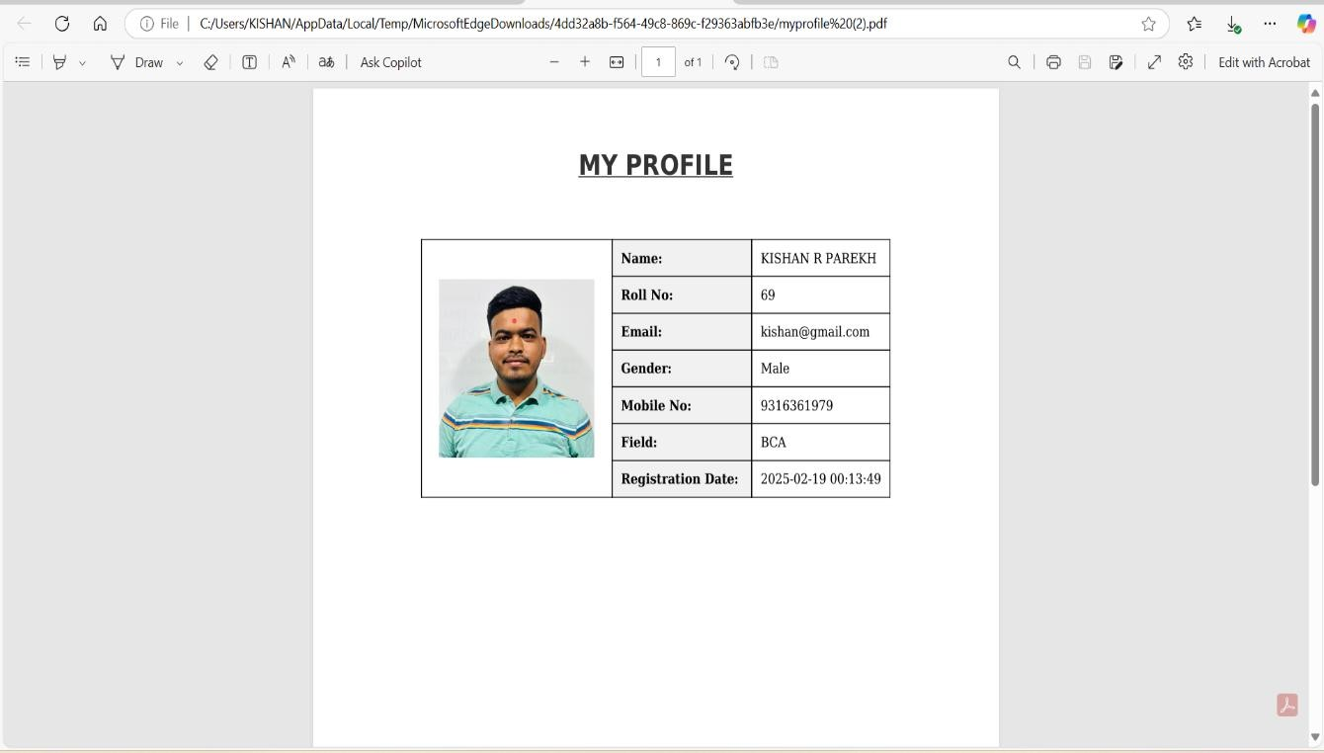
USER DOWNLOAD PROFILE PDF :-
User Profile PDF – A document displaying the user's profile details, including name, roll number, email, gender, mobile number, field, and registration date.
Formatted Layout – The profile is neatly organized in a table with a profile picture, making the information easy to read.

Slide 35
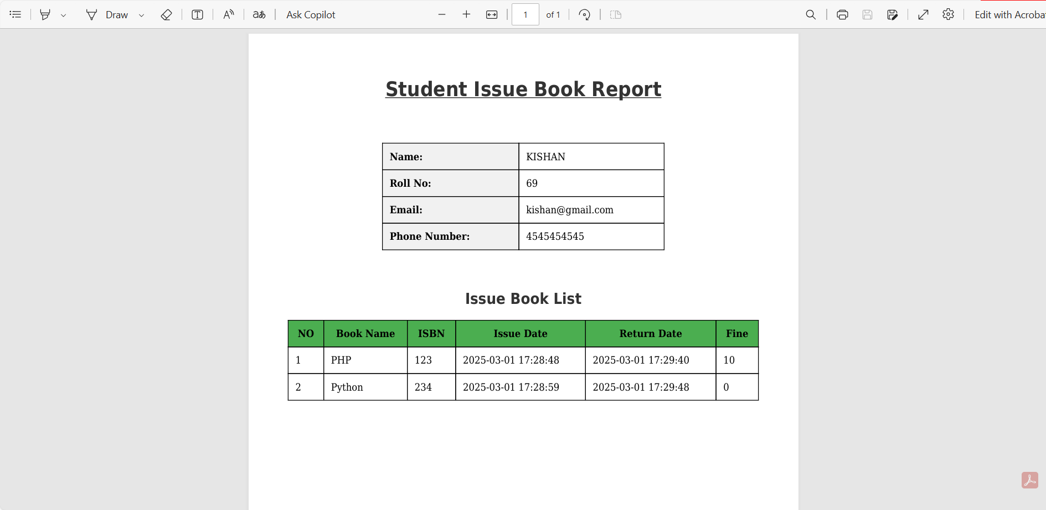
USER DOWNLOAD ISSUEBOOK LIST REPORT PDF :-
Student Book Issue Report – Displays details of a student (Name: Kishan, Roll No: 69) and a list of issued books.
Issued Books & Fines – The table lists books (PHP & Python), their issue/return dates, and any applicable fines.

Slide 36
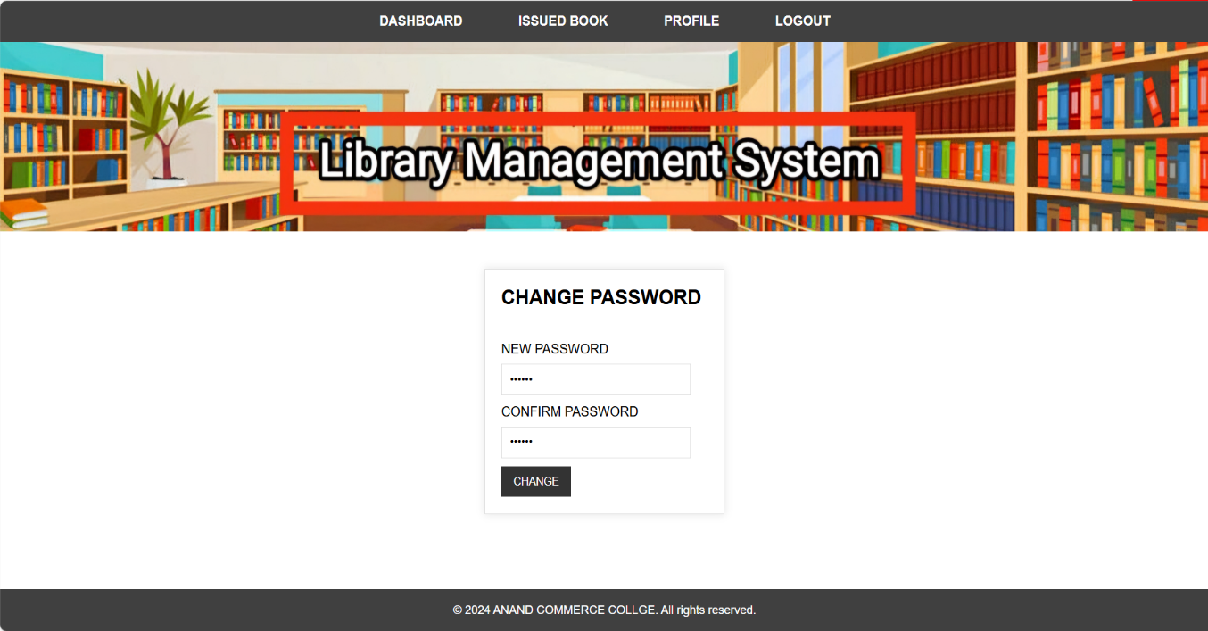
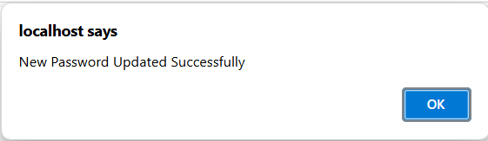
USER CHANGE PASSWORD :-
NEW PASSWORD UPDATE MESSAGE FOR USER :-
The page is part of a Library Management System, allowing users to change their password.
A confirmation message "New Password Updated Successfully" appears after the password change.

Slide 37
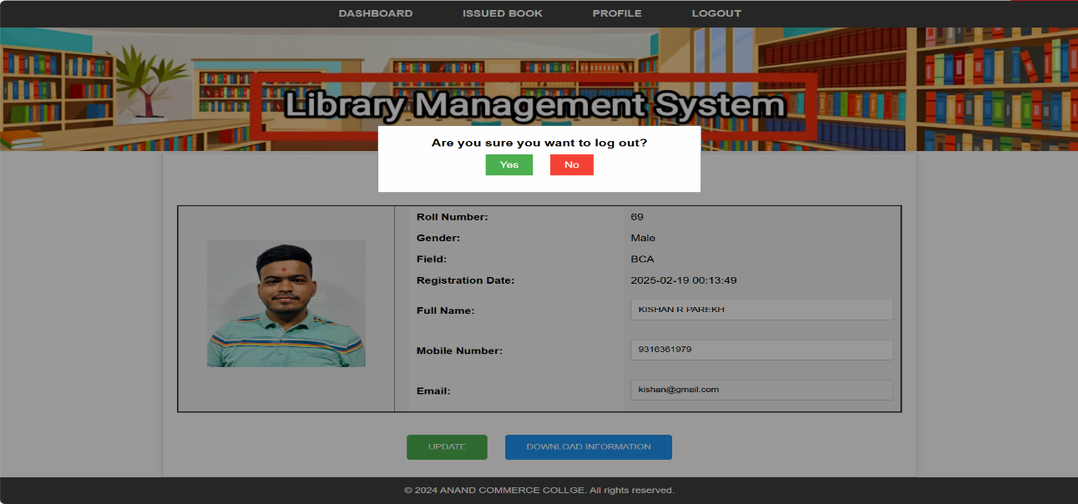
USER LOGOUT :-
Logout Confirmation – A popup asks if the user wants to log out, with "Yes" (green) and "No" (red) buttons.

Slide 38
ADMIN SIDE
INPUT & OUTPUT SCREEN

Slide 39

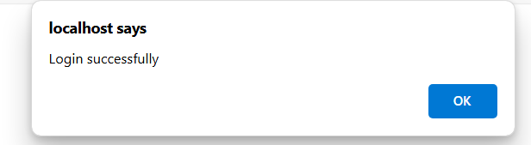
ADMIN LOGIN :-
LOGIN SUCCESSFULLY MESSAGE FOR ADMIN :-
This page is the Admin Login interface of the Library Management System, where the admin enters their email and password to log in.
A confirmation pop-up appears after successful login, indicating "Login successfully."

Slide 40
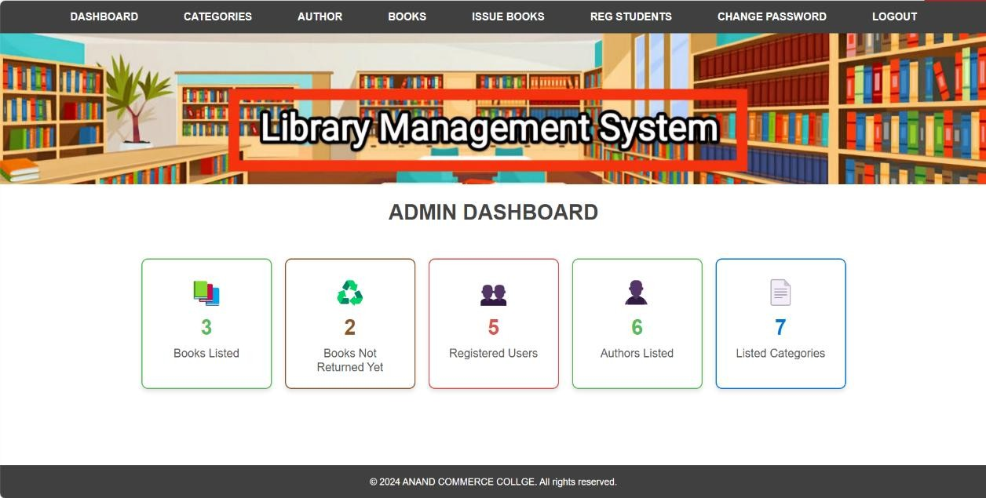
ADMIN DASHBOARD :-
This is the Admin Dashboard of the Library Management System, displaying key statistics like books listed, registered users, and categories.
The navigation menu allows the admin to manage categories, authors, books, issue books, registered students, change passwords, and log out.

Slide 41
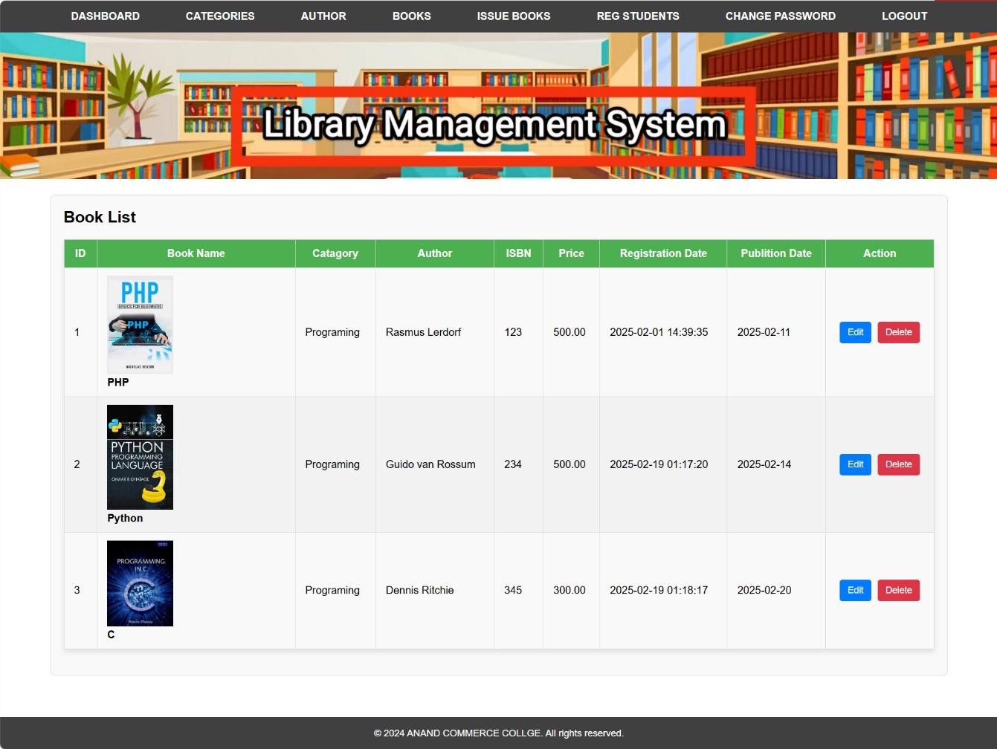
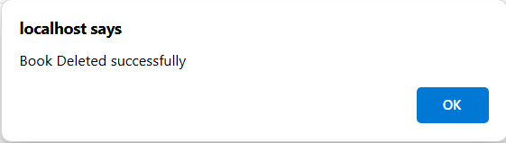
ADMIN VIEW BOOKS OR EDIT AND DELETE BOOK :-
BOOK DELETE SUCCESSFULLY MESSAGE FOR ADMIN :-
Book List Management: Displays book details with edit and delete options.
Deletion Confirmation: Shows a success message when a book is deleted.

Slide 42
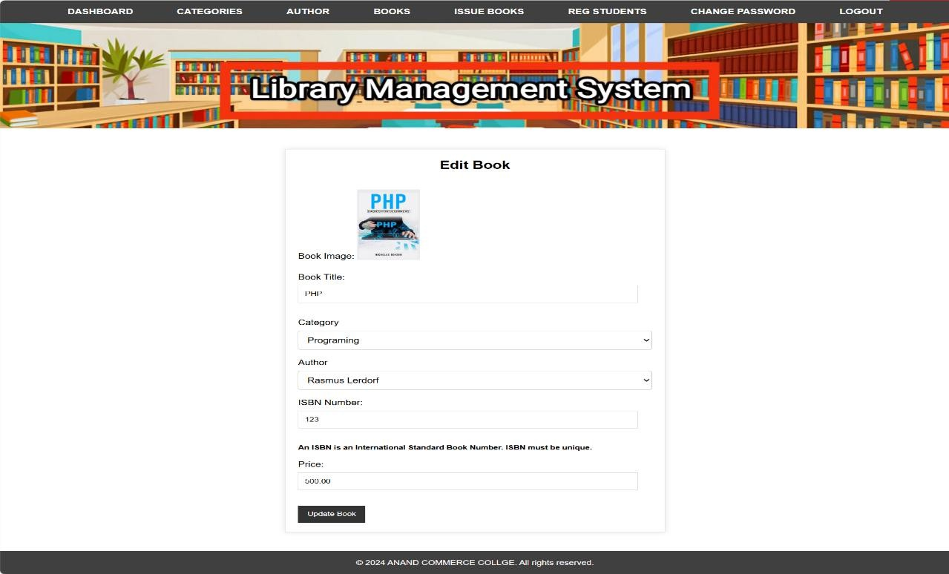

ADMIN EDIT BOOK :-
BOOK UPDATE SUCCESSFULLY MESSAGE FOR ADMIN :-
Edit Book Page: Users can update book details like title, category, author, ISBN, and price.
Success Message: A popup confirms the book was updated successfully.

Slide 43
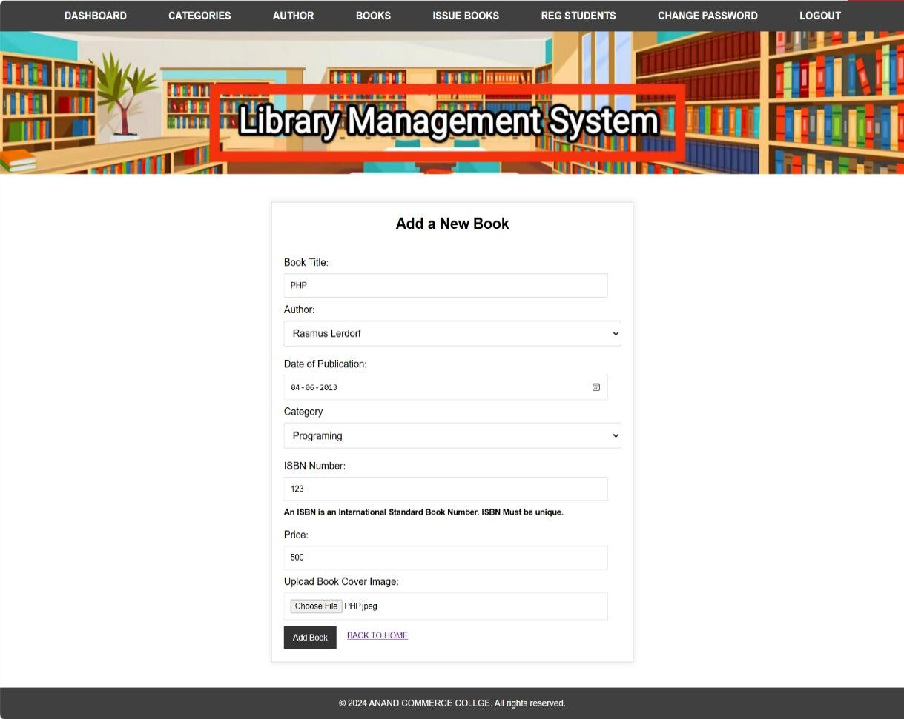

ADMIN ADD BOOK :-
BOOK INSERT SUCCESSFULLY MESSAGE FOR ADMIN :-
This page allows users to add a new book to the library system by entering details like title, author, category, ISBN, price, and uploading a cover image.
After submitting the form, a confirmation popup appears stating "Data inserted successfully," indicating the book was added successfully.

Slide 44
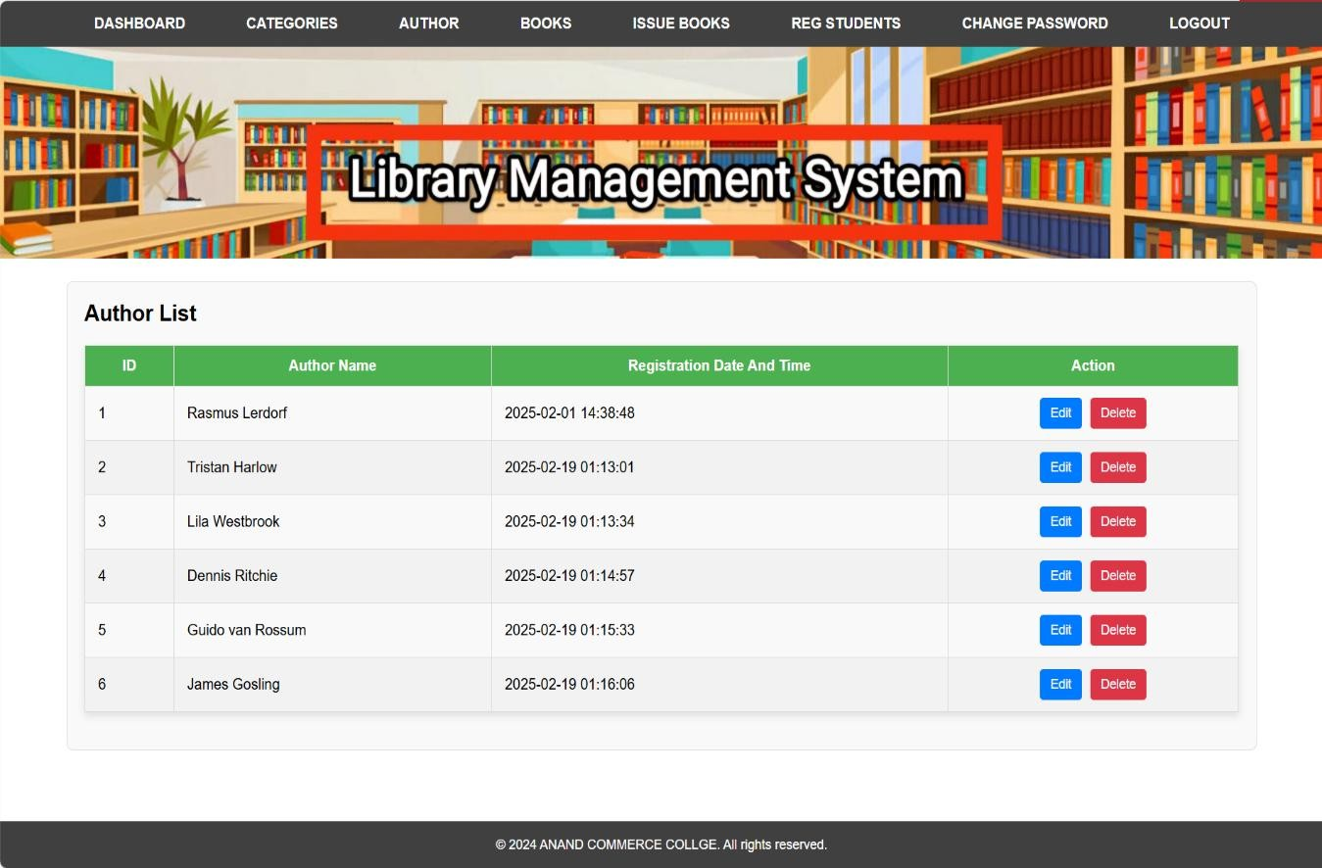
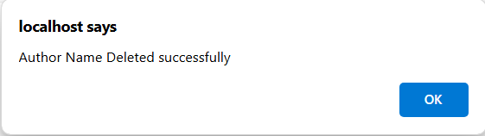
ADMIN VIEW AUTHOR OR EDIT AND DELETE AUTHOR :-
AUTHOR DELETE SUCCESSFULLY MESSAGE FOR ADMIN :-
Author List Management : Shows a list of authors with ID, name, and registration time and You can edit or delete an author.
Deletion Confirmation : A message appears when an author is deleted successfully.

Slide 45
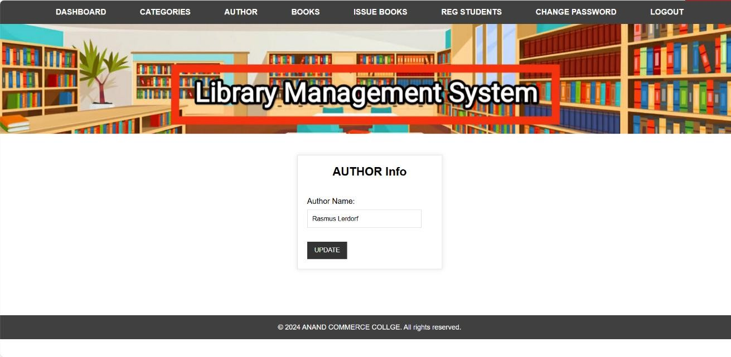

ADMIN EDIT AUTHOR :-
UPDATE AUTHOR SUCCESSFULLY MESSAGE FOR ADMIN :-
Author Update Form – Users can update the author's name in the Library Management System.
Success Message – A confirmation popup appears after a successful update.

Slide 46

ADMIN ADD AUTHOR :-
INSERT AUTHOR SUCCESSFULLY MESSAGE FOR ADMIN :-
Add Author Form – Users can add a new author by entering their name and clicking the "ADD" button.
Success Message – A confirmation popup appears stating "Data inserted successfully" after adding the author.

Slide 47
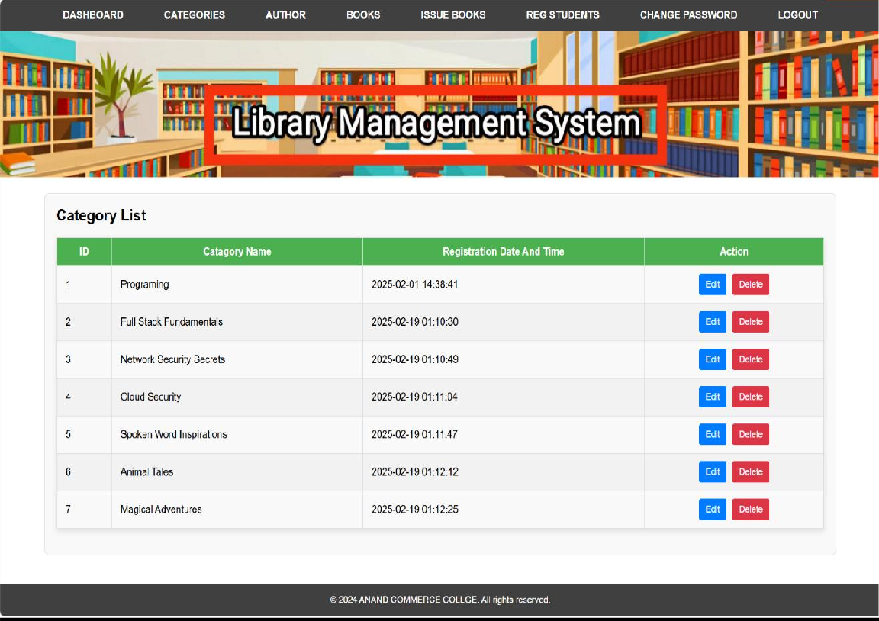
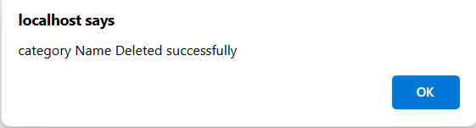
ADMIN VIEW CATEGORY OR EDIT AND DELETE CATEGORY:-
CATEGORY DELETE SUCCESSFULLY MESSAGE FOR ADMIN :-
Category List Page: Displays book categories with options to edit or delete.
Deletion Confirmation: Pop-up message confirms successful category deletion.

Slide 48

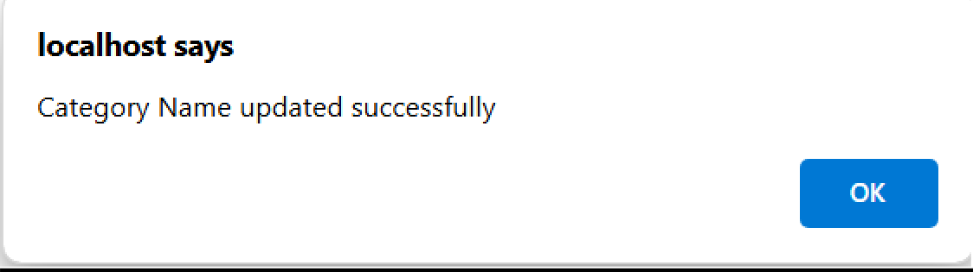
ADMIN EDIT CATEGORY :-
CATEGORY UPDATE SUCCESSFULLY MESSAGE FOR ADMIN :-
Category Management: Users can view, edit, and delete book categories.
Update Confirmation: A popup confirms category updates or deletions.

Slide 49
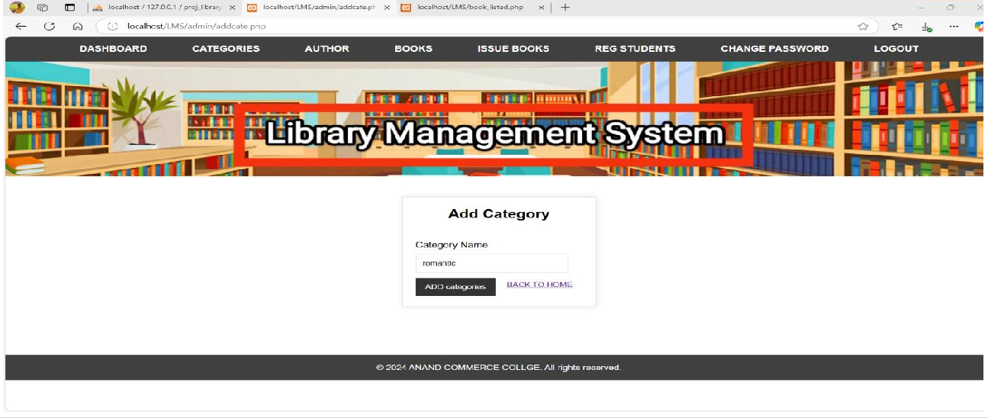
ADMIN ADD CATEGORY :-
CATEGORY ADD SUCCESSFULLY MESSAGE FOR ADMIN :-
Category Addition: The first image shows a "Library Management System" interface where a new book category (e.g., "romantic") is being added.
Confirmation Message: The second image confirms that the category was successfully added with a message: "Data inserted successfully."

Slide 50
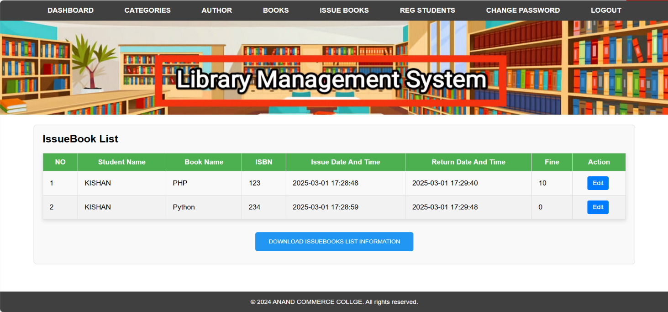
ADMIN VIEW ISSEDBOOK AND EDIT ISSEDBOOK :-
Issued Book List – This page shows a list of issued books with details like Student Name, Book Name, ISBN, Issue Date, Return Date, and Fine.
Edit & Download Options – Users can edit book issue details and download the issued books list.

Slide 51
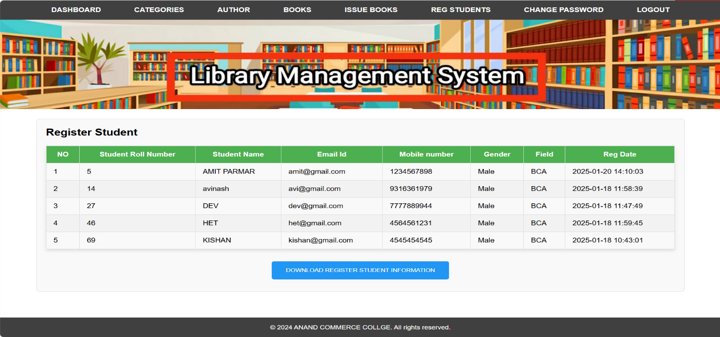
ADMIN VIEW TOTAL REG STUDENT :-
Library Management System – This page displays a list of registered students with details like Roll Number, Name, Email, Mobile Number, Gender, Field, and Registration Date.
Download Option – Users can download the registered student information using the provided button.

Slide 52
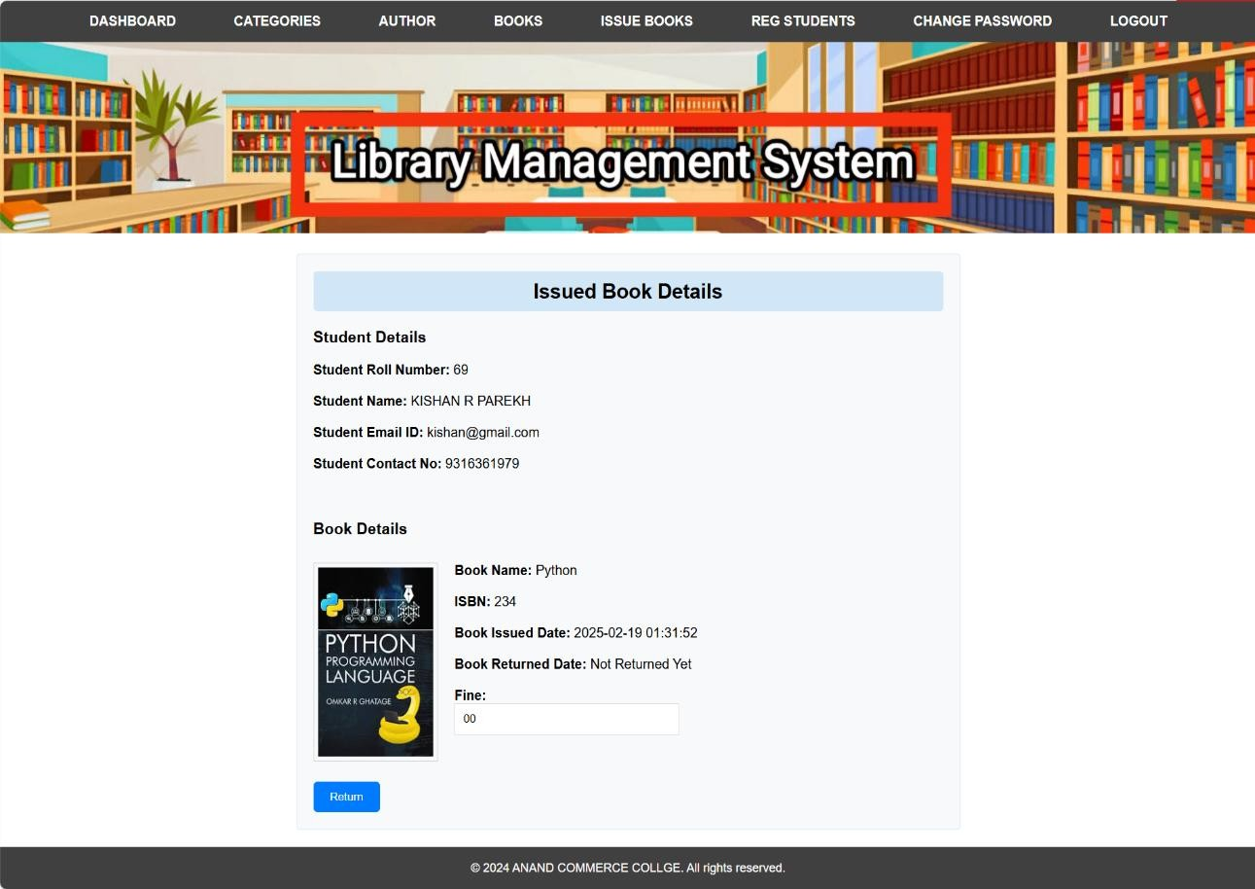
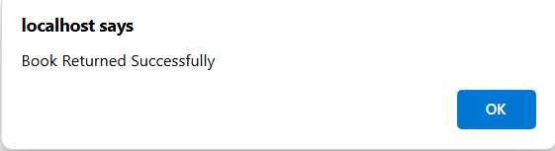
ADMIN EDIT ISSEDBOOK :-
BOOK RETURN SUCCESSFULLY MESSAGE FOR ADMIN :-
Issued Book Details – Displays student and book information, including the student's roll number, name, email, contact number, book name, ISBN, issue date, return status, and any applicable fine.
Book Return Confirmation – After returning the book, a confirmation message appears, stating "Book Returned Successfully."

Slide 53
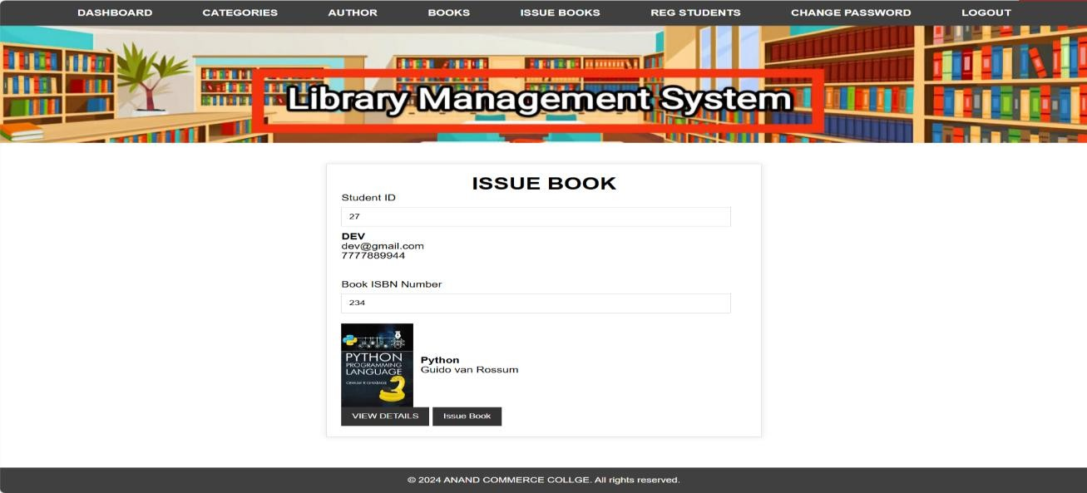
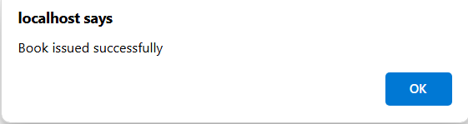
ADMIN ADD ISSEDBOOK :-
BOOK ISSUED SUCCESSFULLY MESSAGE FOR ADMIN :-
A student can issue a book using their Roll Number along with the Book ISBN Number in the library management system.
The page facilitates book issuance to students in a library management system with confirmation messages.

Slide 54
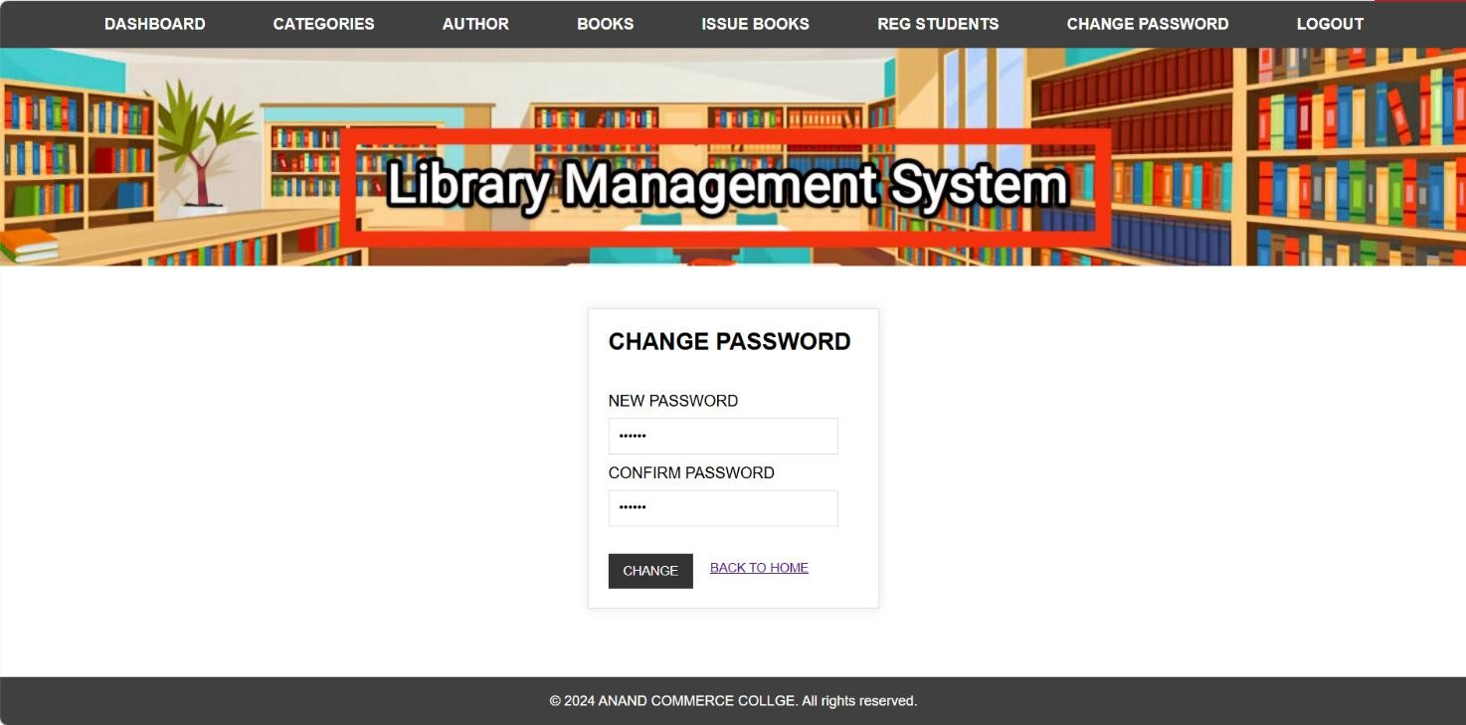
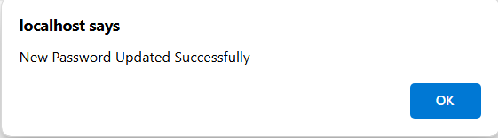
ADMIN CHANGE PASSWORD :-
NEW PASSWORD UPDATE SUCCESSFULLY MESSAGE FOR ADMIN :-
The page is part of a Library Management System, allowing users to change their password.
A confirmation message "New Password Updated Successfully" appears after the password change.

Slide 55
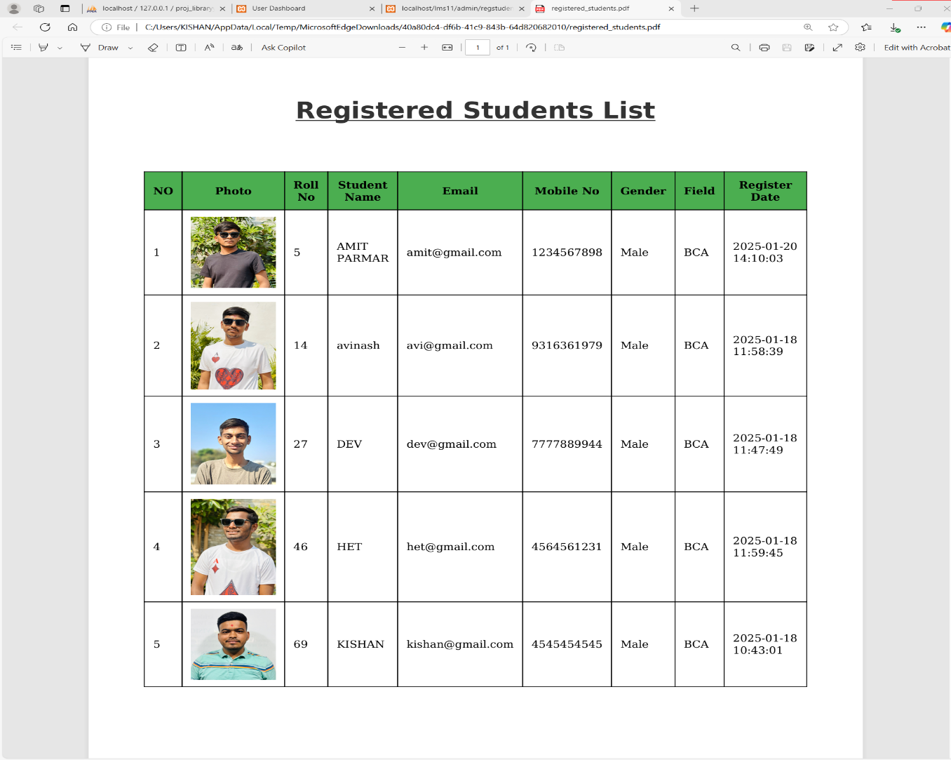
TOTAL STUDENTS PDF REPORT :-
Registered Students List – Displays details of students, including roll number, name, email, mobile number, gender, field of study, and registration date.
Photo Inclusion – Each student entry includes a profile photo for easy identification.

Slide 56
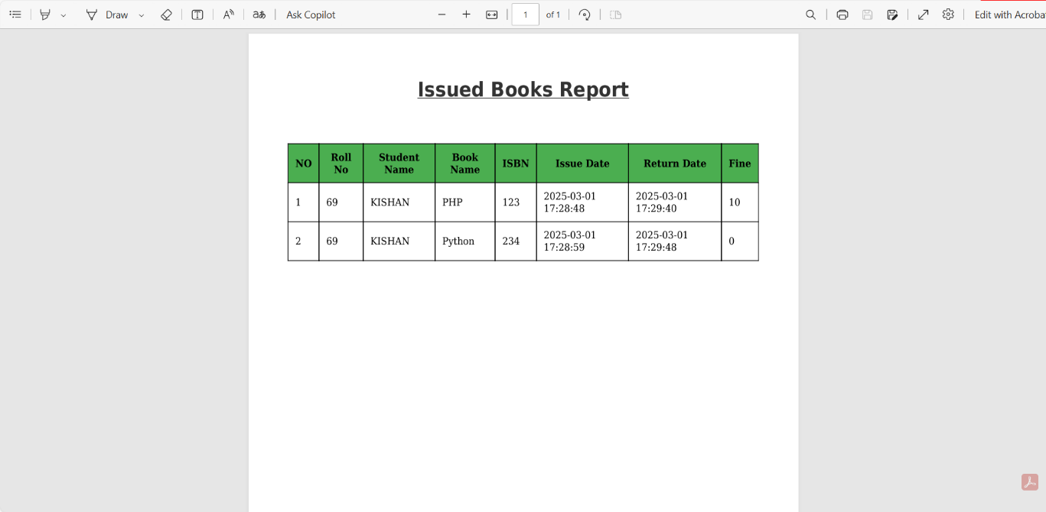
TOTAL STUDENTS ISSUED BOOK PDF REPORT :-
Issued Books Report – Displays details of books issued to students, including roll number, name, book name, ISBN, issue and return dates, and fines.
Fine Details – Shows any applicable fines for late returns, such as ₹10 for the PHP book and ₹0 for the Python book.

Slide 57
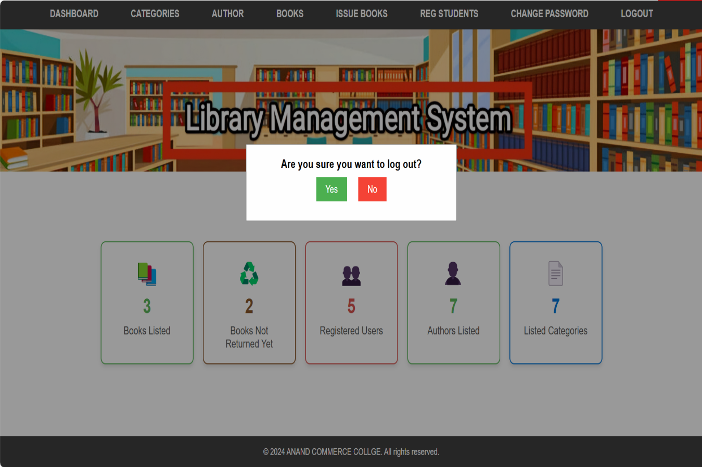
ADMIN LOGOUT :-
Logout Confirmation – A popup asks if the user wants to log out, with "Yes" (green) and "No" (red) buttons.

Slide 58
15. Validation
1.PHP Validation: Ensures user input meets specific criteria, preventing errors, data corruption, and security issues.
2.Required Field Validation: Ensures essential fields are not left empty, such as name, email, etc.
3.String Validation: Verifies strings meet specific formats (e.g., valid email address or URL) using functions like filter_var().
4.Number Validation: Ensures numeric input is of the correct type and falls within a valid range (e.g., age, price).
5.Regex (Regular Expression) Validation: Uses patterns to check if a string matches a specified format, useful for phone numbers, postal codes, etc.
6.Length Validation: Ensures input meets length requirements, such as for passwords or usernames, preventing weak or overly long inputs.
7.Email Validation: Ensures the input is a valid email address format (e.g., user@example.com).
8.File Upload Validation: Ensures uploaded files meet criteria such as valid file type and size, protecting the server from security risks.

Slide 59
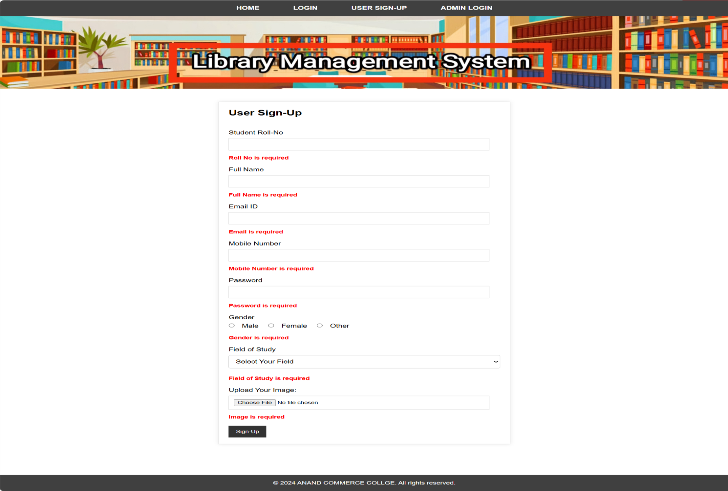
REQUIRED FIELD VALIDATION :-
User Sign-Up Form with Validation: Ensures all required fields (Roll No, Name, Email, Mobile, Password, Gender, Field of Study, Image) are filled. Shows red error messages for missing details.

Slide 60
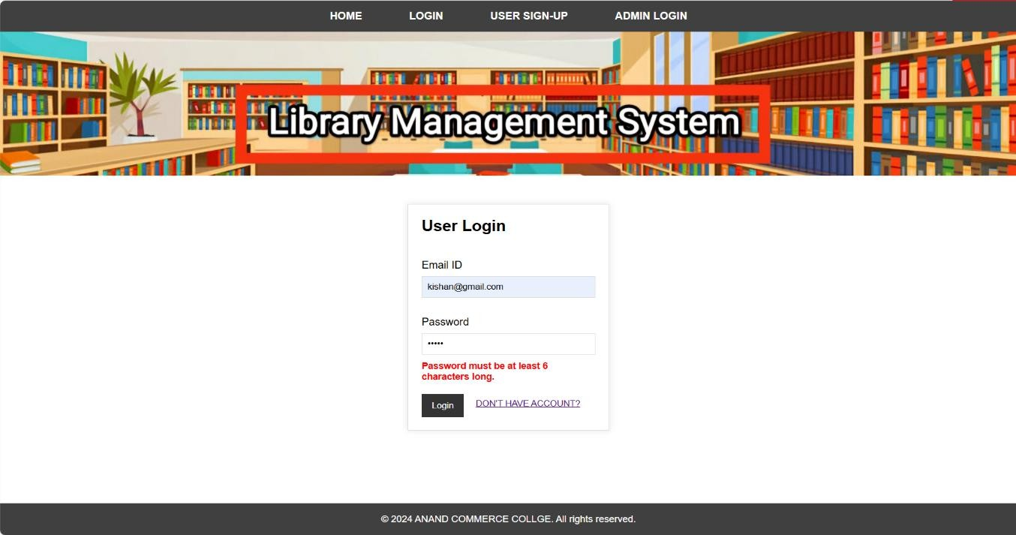
LENGTH VALIDATION :-
User Login Form with Validation: Ensures email and password are entered correctly. Displays an error if the password is less than 6 characters.

Slide 61
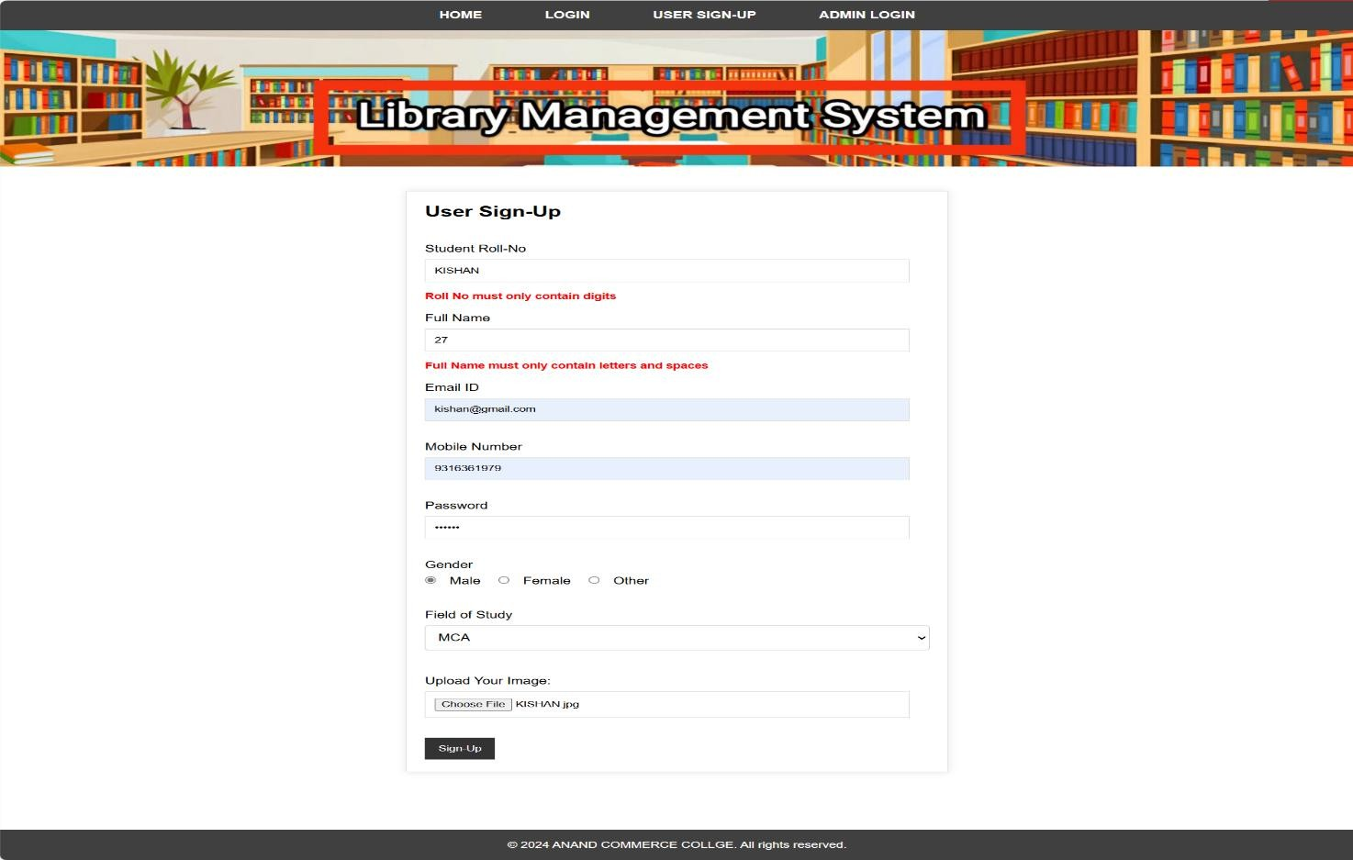
STRING VALIDATION & NUMBER VALIDATION :-
Sign-Up Form Validation: Checks Roll No (digits only), Full Name (letters only), Email, Mobile, Password, Gender, and Field of Study. Shows errors for incorrect input.

Slide 62
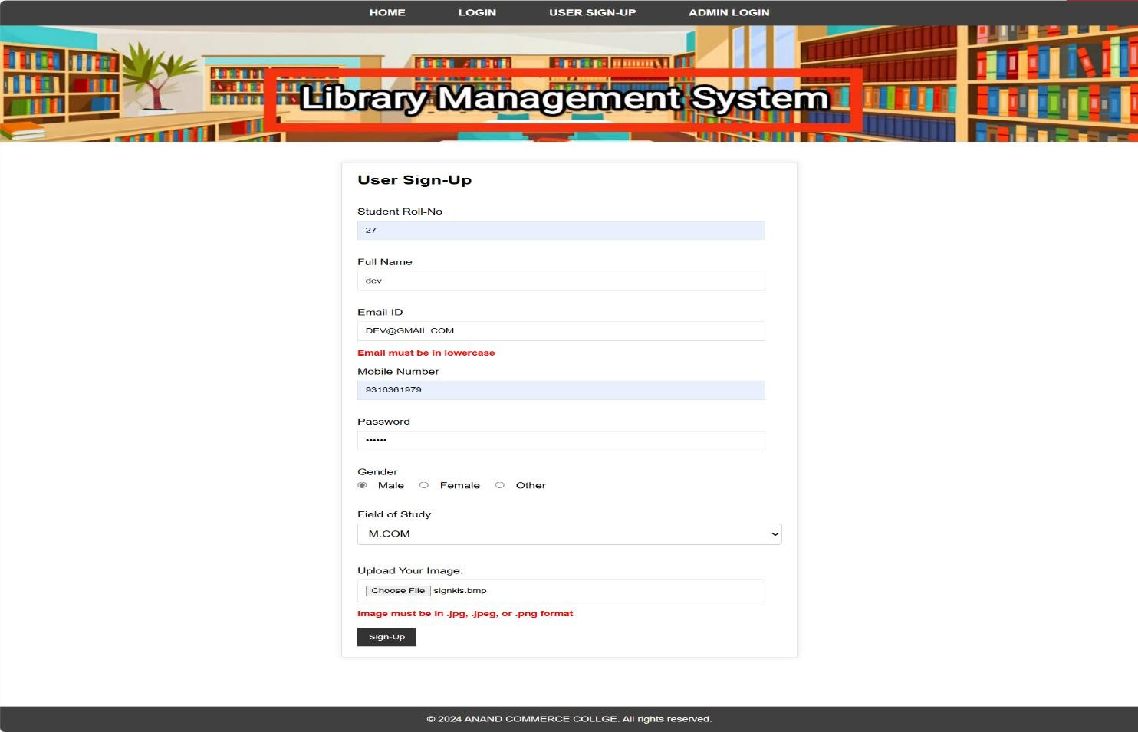
EMAIL VALIDATION & FILE UPLOAD VALIDATION :-
User Sign-Up Form with Validation: Checks required fields like Roll No, Name, Email, and Password. Ensures the email is in lowercase and the uploaded image is in .jpg, .jpeg, or .png format. Displays errors for invalid inputs.

Slide 63
16. Testing Procedures & Implementation Phases
1) Unit Testing: Test individual parts of the system to ensure they work properly.
2) Integration Testing: Check if different parts of the system work together as expected.
3) System Testing: Test the entire system to ensure all components function together smoothly.
4) Acceptance Testing: Ensure the system is easy to use and meets the needs of users.

Slide 64
17. LIMITATIONS
1) Scalability Issues: The system may slow down or become inefficient as the number of books and users increases if it isn't built to handle large data volumes.
2) Single Admin Role: Having only one admin role can overwhelm the admin with all tasks like maintenance and user management.
3) Student Only Role: A single student role limits options for personalizing experiences or tracking detailed reading history.
4) Poor Communication Between Admin and Students: Without interactive features, students may miss important announcements or book recommendations.
5) No Feedback Mechanism: Lack of a feedback system means students can't share their thoughts or report issues, limiting improvements.

Slide 65
18. FUTURE ENHACEMENT
Voice Search: Let students search for books using voice commands, making it easier to use.
2) Dedicated Mobile Application: Create an app for students and admins to access the library anytime, with features like barcode scanning and overdue reminders.
3) Push Notifications: Send alerts to students about due dates, new books, or book availability.
4) AI-Powered Search: Use AI to make searches more accurate, correcting mistakes and understanding context.
5) Recommendation System: Suggest books based on students’ reading history or interests.
6) Integration with National or International Catalogs: Connect the system to global library catalogs for easier access to more resources.
7) Forgot Password: Add a feature to help users recover their password if they forget it.

Slide 66
19. CONCLUSION
In conclusion, the Library Management System (LMS) plays a crucial role in efficiently managing the operations of a library, ensuring that both admins and users can interact with the system seamlessly. With a structured approach to managing books, authors, categories, and user information, the system enables enhanced workflow and resource organization.
For admin users, the system provides comprehensive features such as secure login, a centralized dashboard for easy management, and tools for adding or updating categories, authors, and books. It also allows the management of issued books, student details, and the ability to log out securely.
On the user side, the system supports secure login and registration, with a personalized dashboard for each user. They can easily view book details, check the status of their issued books, manage their profiles, and update their information as needed. The secure logout functionality ensures that all users' data is kept protected at all times.
Overall, this system simplifies library operations, enhances user experience, and ensures smooth management for both admins and users, making it an indispensable tool for modern libraries.

Slide 67
20. BIBLIOGRAPHY
www.google.com
https://www.w3schools.com/php/
www.youtube.com
https://phpgurukul.com

Slide 68


